Slide 1
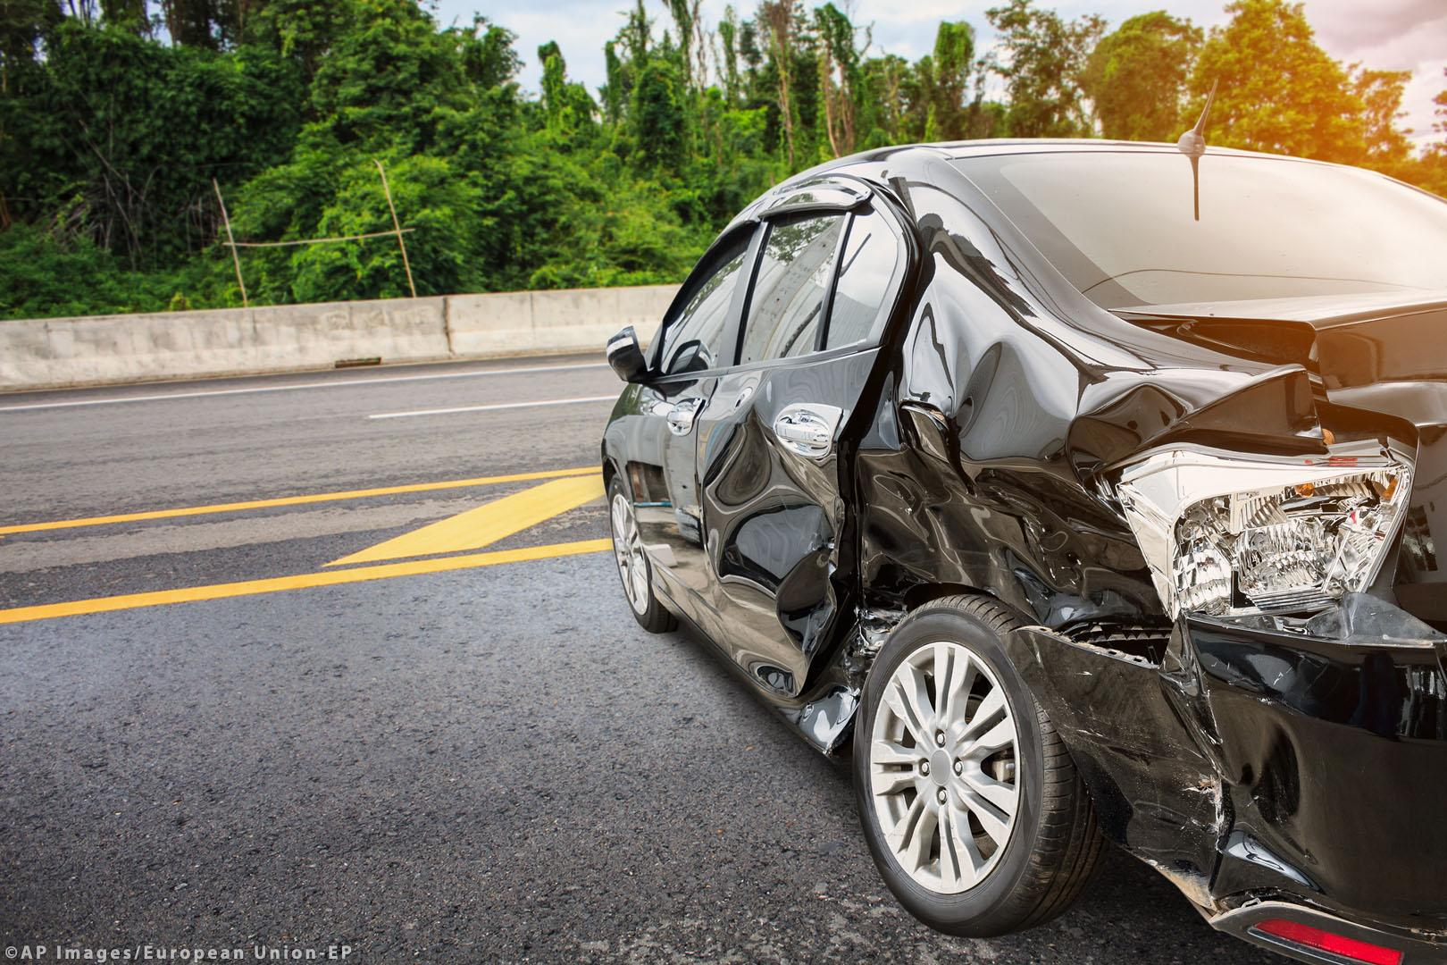
ETL PROJECT

Slide 2
!

Slide 3
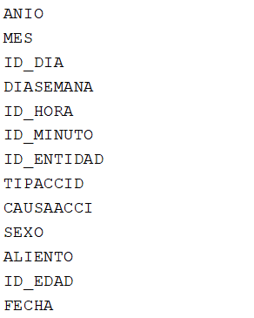
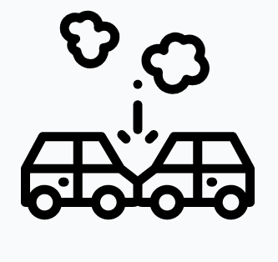
Car Accidents from 2013 - 2017
INEGI (by event)
DATA EXTRACT

Slide 4
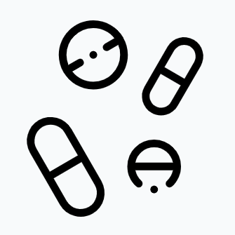
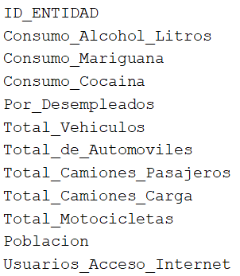
Entity macro indicators 2017
CONADIC(Comisión Nacional de las Adicciones),
INEGI ( by entity)
DATA EXTRACT

Slide 5
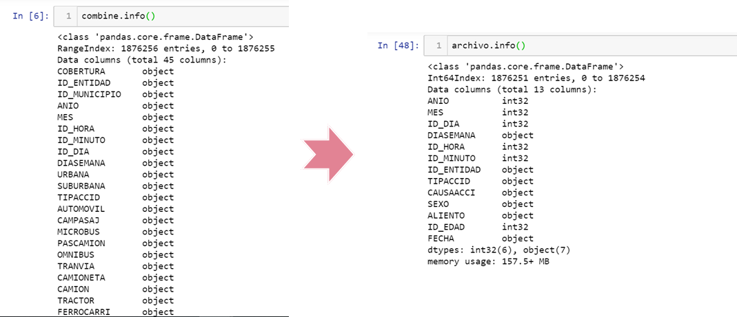
DATA TRANSFORMATION

Slide 6
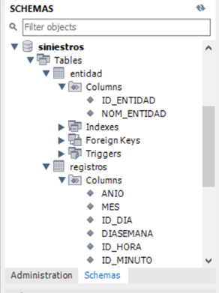
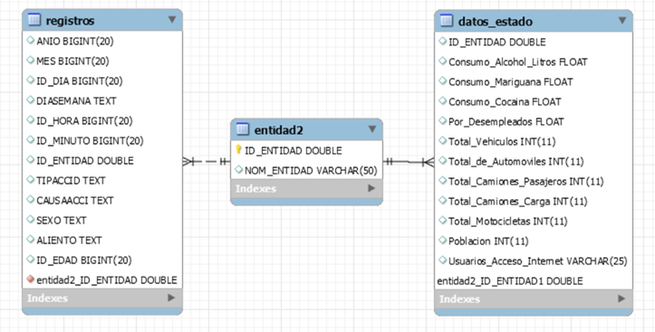
DATA LOAD

